Slide 1
Artificial Neural Networks

Slide 2
Introduction To Artificial Neural Networks
ANN are a promising new generation of Information processing systems that demonstrate the ability to learn, recall & generalize from training patterns or data
ANNs are systems that are deliberately constructed to make use of some organizational principles resembling those of human brain
ANNs are inspired by modeling networks of biological neurons in the brain

Slide 3
Biological Motivation
Human brain is a densely interconnected network of approximately 10¹¹ neurons, each connected to, on average, 10⁴ others.
Neuron activity is excited or inhibited through connections to other neurons.
The fastest neuron switching times are known to be on the order of 10⁻³ sec.

Slide 4

Principles of Brain Processing
How our brain manipulates with patterns ?
A process of pattern recognition and pattern manipulation is based on:
Connectionism
Brain computer is a highly interconnected neurons system in such a way that the state of one neuron affects the potential of the large number of other neurons which are connected according to weights or strength. The key idea of such principle is the functional capacity of biological neural nets determs mostly not so of a single neuron but of its connections
Associative distributed memory
Storage of information in a brain is supposed to be concentrated in synaptic connections of brain neural network, or more precisely, in the pattern of these connections and strengths (weights) of the synaptic connections.
Massive parallelism
Brain computer as an information or signal processing system, is composed of a large number of a simple processing elements, called neurons. These neurons are interconnected by numerous direct links, which are called connection, and cooperate which other to perform a parallel distributed processing (PDP) in order to soft a desired computation tasks.

Slide 5


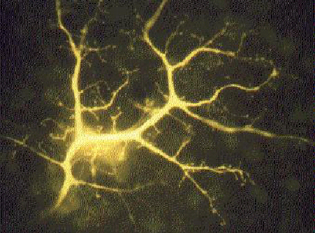
Brain Computer: What is it?
Human brain contains a massively interconnected net of 10¹⁰-10¹¹ (10 billion) neurons (cortical cells)
Biological Neuron
- The simple “arithmetic computing” element

Slide 6
Biological Neurons
Soma or body cell - is a large, round central body in which almost all the logical functions of the neuron are realized.
The axon (output), is a nerve fibre attached to the soma which can serve as a final output channel of the neuron. An axon is usually highly branched.
The dendrites (inputs)- represent a highly branching tree of fibres. These long irregularly shaped nerve fibres (processes) are attached to the soma.
Synapses are specialized contacts on a neuron which are the termination points for the axons from other neurons.
Synapses
Axon from other neuron
Soma
Dendrite from other
Axon
Dendrites
The schematic model of a biological neuron

Slide 7
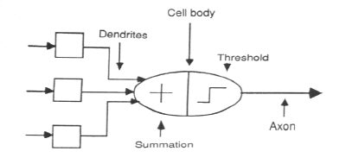
ASSOCIATION OF BIOLOGICAL NET
WITH ARTIFICIAL NET

Slide 8
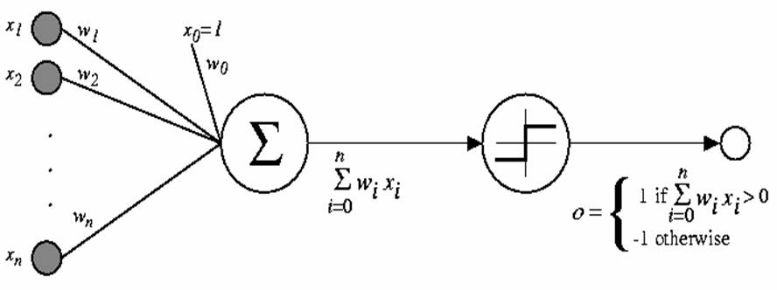
Schematic diagram of McCulloch & Pitts Neuron
In this model, the i^{th} processing element computes a weighted sum of its inputs and outputs 1 (firing) or 0 (not firing) according to whether this weighted input sum is above or below a certain threshold θ_{i}

Slide 9
DEFINITION OF NEURAL NETWORKS
According to the DARPA Neural Network Study
(1988, AFCEA International Press, p. 60):
• ... a neural network is a system composed of
many simple processing elements operating in
parallel whose function is determined by network
structure, connection strengths, and the
processing performed at computing elements or
nodes.

Slide 10
According to Haykin (1994), p. 2:
• A neural network is a massively parallel
distributed processor that has a natural
propensity for storing experiential knowledge
and making it available for use. It resembles
the brain in two respects:
– Knowledge is acquired by the network through a learning process.
– Inter-neuron connection strengths known as synaptic weights are used to store the knowledge.

Slide 11
Background and Motivation
History of Artificial Neural Networks
Creation:
1890: William James - defined a neuronal process of learning
Promising Technology:
1943: McCulloch and Pitts - earliest mathematical models
1954: Hebb and IBM research group - earliest simulations
1958: Frank Rosenblatt - The Perceptron
Disenchantment:
1969: Minsky and Papert - perceptrons have severe limitations
Re-emergence:
1985: Multi-layer nets that use back-propagation
1986: PDP Research Group - multi-disciplined approach

Slide 12
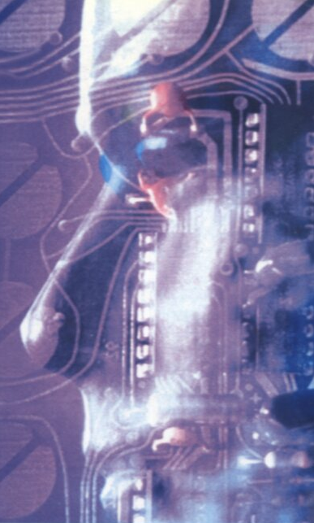
Brain-like Computer
Artificial Neural Network – Mathematical Paradigms of Brain-Like Computer
The new paradigm of computing mathematics consists of the combination of such artificial neurons into some artificial neuron net.
Neurons and Neural Net
Brain-Like Computer
Brain-like computer –
is a mathematical model of humane-brain principles of computations. This computer consists of those elements which can be called the biological neuron prototypes, which are interconnected by direct links called connections and which cooperate to perform parallel distributed processing (PDP) in order to solve a desired computational task.
?

Slide 13
ANN as a Brain-Like Computer
NN as an model of brain-like Computer
An artificial neural network (ANN) is a massively parallel distributed processor that has a natural propensity for storing experimental knowledge and making it available for use. It means that:
Knowledge is acquired by the network through a learning (training) process;
The strength of the interconnections between neurons is implemented by means of the synaptic weights used to store the knowledge.
The learning process is a procedure of the adapting the weights with a learning algorithm in order to capture the knowledge. On more mathematically, the aim of the learning process is to map a given relation between inputs and output (outputs) of the network.
Brain
The human brain is still not well understood and indeed its behavior is very complex!
There are about 10 billion neurons in the human cortex and 60 trillion synapses of connections
The brain is a highly complex, nonlinear and parallel computer (information-processing system)

Slide 14
Applications of Artificial Neural Networks
Intelligent Control
Advance Robotics
Technical Diagnistics
Machine Vision
Intelligent
Data Analysis
and Signal Processing
Artificial Intellect with Neural Networks
Image & Pattern Recognition
Intelligent Expert Systems
Intelligentl Medicine Devices
Intelligent Security Systems

Slide 15
Image Recognition: Decision Rule and Classifier
Is it possible to formulate (and formalize!) the decision rule, using which we can classify or recognize our objects basing on the selected features?
Can you propose the rule using which we can definitely decide is it a tiger or a rabbit?

Slide 16
Image Recognition: Decision Rule and Classifier
Once we know our decision rule, it is not difficult to develop a classifier, which will perform classification/recognition using the selected features and the decision rule.
However, if the decision rule can not be formulated and formalized, we should use a classifier, which can develop the rule from the learning process

Slide 17
Image Recognition: Decision Rule and Classifier
In the most of recognition/classification problems, the formalization of the decision rule is very complicated or impossible at all.
A neural network is a tool, which can accumulate knowledge from the learning process.
After the learning process, a neural network is able to approximate a function, which is supposed to be our decision rule

Slide 18
Why neural network?
- unknown multi-factor decision rule
Learning process using a representative learning set
- a set of weighting vectors is the result of the learning process
- a partially defined function, which is an approximation of the decision rule function

Slide 19
Mathematical Interpretation of Classification in Decision Making
1. Quantization of pattern space into p decision classes
x_{i}
y_{i}
m₁
m₂
m_{p}
m₃
2. Mathematical model of quantization:
“Learning by Examples”
Input Patterns
Response:

Slide 20
Intelligent Data Analysis in Engineering Experiment
Interpretation
and
Decision Making
Rules
&
Knowledge
Productions
Engineering Experiment
Data
Analysis
Characteristics
&
Estimations
Data
Acquisition
Signals
&
parameters
Adaptive Machine Learning
via Neural Network
Data
Acquisition
Data
Analysis
Decision Making
Knowledge
Base

Slide 21
Learning via Self-Organization Principle
Self-organization – basic principle of learning:
Structure reconstruction
The learning involves change of structure
Responce
Input Images
Neuroprocessor
Learning Rule
Teacher

Slide 22
Symbol Manipulation or Pattern Recognition ?
Ill-Formalizable Tasks:
Sound and Pattern recognition
Decision making
Knowledge discovery
Context-Dependent Analysis
Which way of imagination is best for you ?
What is difference between human brain and traditional computer via specific approaches to solution of ill-formalizing tasks (those tasks that can not be formalized directly)?
Symbol manipulation
Pattern recognition
Dove flies
Lion goes
Tortoise scrawls
Donkey sits
Shark swims

Slide 23
Artificial Neuron
A neuron has a set of n synapses associated to the inputs. Each of them is characterized by a weight .
A signal at the i^{th} input is multiplied (weighted) by the weight
The weighted input signals are summed. Thus, a linear combination of the input signals is obtained. A "free weight" (or bias) , which does not correspond to any input, is added to this linear combination and this forms a weighted sum .
A nonlinear activation function φ is applied to the weighted sum. A value of the activation function is the neuron's output.
x₁
w₁
x₂
y
w₂
x_{n}
w_{n}

Slide 24
A Neuron
f is a function to be earned
are the inputs
φ is the activation function
Z is the weighted sum

Slide 25
A Neuron
Neurons’ functionality is determined by the nature of its activation function, its main properties, its plasticity and flexibility, its ability to approximate a function to be learned

Slide 26
BUILDING BLOCKS OF ARTIFICIAL
NEURAL NET
Network Architecture (Connection between Neurons)
Setting the Weights (Training)
Activation Function

Slide 27
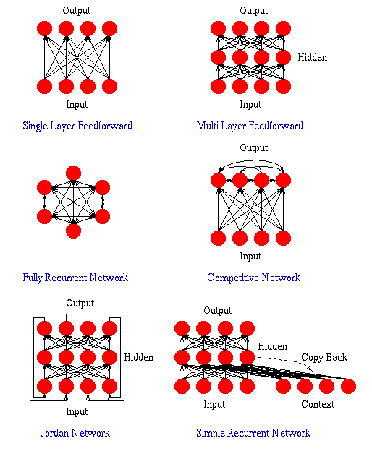

Slide 28
LAYER PROPERTIES
Input Layer: Each input unit may be designated by an attribute value possessed by the instance.
Hidden Layer: Not directly observable, provides nonlinearities for the network.
Output Layer: Encodes possible values.

Slide 29
TRAINING PROCESS
Supervised Training - Providing the network with a series of sample inputs and comparing the output with the expected responses.
Unsupervised Training - Most similar input vector is assigned to the same output unit.
Reinforcement Training - Right answer is not provided but indication of whether ‘right’ or ‘wrong’ is provided.
Gradient descent learning – This is based on the minimization of error E defined in terms of weights & the activation function of the network.
Competitive learning – Here, those neurons which respond strongly to input stimuli have their weights updated. When an input pattern is presented, all neurons in the layer compete & the winning neuron undergoes weight adjustment.

Slide 30
Different types of Learning Rules
Supervised learning
X
Unsupervised learning
X
Reinforcement learning
ANN
W
Y (Actual Output)
Error Signals
Error Signal Generator
D (Desired Output)
ANN
W
Y (Actual Output)

Slide 31
ACTIVATION FUNCTION
ACTIVATION LEVEL – DISCRETE OR
CONTINUOUS
HARD LIMIT FUCNTION (DISCRETE)
Binary Activation function
Bipolar activation function
Identity function
SIGMOIDAL ACTIVATION FUNCTION (CONTINUOUS)
Binary Sigmoidal activation function
Bipolar Sigmoidal activation function

Slide 32
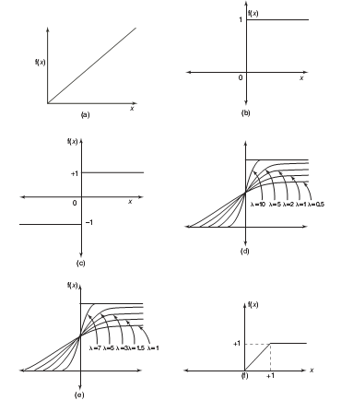
ACTIVATION FUNCTION
Activation functions:
(A)Identity
(B)Binary step
(C)Bipolar step
(D)Binary sigmoidal
(E)Bipolar sigmoidal
(F)Ramp

Slide 33
CONSTRUCTING ANN
Determine the network properties:
Network topology
Types of connectivity
Order of connections
Weight range
Determine the node properties:
Activation range
Determine the system dynamics
Weight initialization scheme
Activation – calculating formula
Learning rule

Slide 34
Principles of Neurocomputing
Connectionizm
NN is a highly interconnected structure in such a way that the state of one neuron affects the potential of the large number of another neurons to which it is connected accordiny to weights of connections
Not Programming but Training
NN is trained rather than programmed to perform the given task since it is difficult to separate the hardware and software in the structure. We program not solution of tasks but ability of learning to solve the tasks
Y
A
Distributed Memory
NN presents an distributed memory so that changing-adaptation of synapse can take place everywhere in the structure of the network.

Slide 35

Principles of Neurocomputing
A
Learning and Adaptation
NN are capable to adapt themselves (the synapses connections between units) to special environmental conditions by changing their structure or strengths connections.
A
Non-Linear Functionality
Every new states of a neuron is a nonlinear function of the input pattern created by the firing nonlinear activity of the other neurons.
Robustness of Assosiativity
NN states are characterized by high robustness or insensitivity to noisy and fuzzy of input data owing to use of a highly redundance distributed structure

Slide 36
Threshold Neuron (Perceptron)
Output of a threshold neuron is binary, while inputs may be either binary or continuous
If inputs are binary, a threshold neuron implements a Boolean function
The Boolean alphabet {1, -1} is usually used in neural networks theory instead of {0, 1}. Correspondence with the classical Boolean alphabet {0, 1} is established as follows:

Slide 37
Threshold Boolean Functions
The Boolean function is called a threshold (linearly separable) function, if it is possible to find such a real-valued weighting vector that equation
holds for all the values of the variables x from the domain of the function f.
Any threshold Boolean function may be learned by a single neuron with the threshold activation function.

Slide 38
Threshold Boolean Functions: Geometrical Interpretation
XOR is an example of the non-threshold (not linearly separable) Boolean function: it is impossible separate “1s” from “-1s” by any single line
“OR” (Disjunction) is an example of the threshold (linearly separable) Boolean function:
“-1s” are separated from “1” by a line
1 1→ 1
1 -1→ -1
-1 1→ -1
-1 -1→ -1
1 1 → 1
1 -1→ -1
-1 1→ -1
-1 -1→ 1

Slide 39
Threshold Neuron: Learning
A main property of a neuron and of a neural network is their ability to learn from its environment, and to improve its performance through learning.
A neuron (a neural network) learns about its environment through an iterative process of adjustments applied to its synaptic weights.
Ideally, a network (a single neuron) becomes more knowledgeable about its environment after each iteration of the learning process.

Slide 40
Threshold Neuron: Learning
Let us have a finite set of n-dimensional vectors that describe some objects belonging to some classes (let us assume for simplicity, but without loss of generality that there are just two classes and that our vectors are binary). This set is called a learning set:

Slide 41
Threshold Neuron: Learning
Learning of a neuron (of a network) is a process of its adaptation to the automatic identification of a membership of all vectors from a learning set, which is based on the analysis of these vectors: their components form a set of neuron (network) inputs.
This process should be utilized through a learning algorithm.

Slide 42
Threshold Neuron: Learning
Let T be a desired output of a neuron (of a network) for a certain input vector and Y be an actual output of a neuron.
If T=Y, there is nothing to learn.
If T≠Y, then a neuron has to learn, in order to ensure that after adjustment of the weights, its actual output will coincide with a desired output

Slide 43
Error-Correction Learning
If T≠Y, then is the error .
A goal of learning is to adjust the weights in such a way that for a new actual output we will have the following:
That is, the updated actual output must coincide with the desired output.

Slide 44
Error-Correction Learning
The error-correction learning rule determines how the weights must be adjusted to ensure that the updated actual output will coincide with the desired output:
α is a learning rate (should be equal to 1 for the threshold neuron, when a function to be learned is Boolean)

Slide 45
Learning Algorithm
Learning algorithm consists of the sequential checking for all vectors from a learning set, whether their membership is recognized correctly. If so, no action is required. If not, a learning rule must be applied to adjust the weights.
This iterative process has to continue either until for all vectors from the learning set their membership will be recognized correctly or it will not be recognized just for some acceptable small amount of vectors (samples from the learning set).

Slide 46
Classification Systems and Inductive Learning
Vector Representation & Discriminate Functions
x
“Input or Attribute
Space”
2
o
o
Height
A
o
o
o
Class Clusters
*
BB
*
*
*
*
Age
x
1

Slide 47
Classification Systems and Inductive Learning
Vector Representation & Discriminate Functions
Linear Discriminate
Function
x
2
o
f(X)=(x₁,x₂) =
w₀+w₁x₁+w₂x₂=0
or WX = 0
f(x₁,x₂) > 0 => A
f(x₁,x₂) < 0 => B
o
Height
A
o
o
o
*
B
*
*
*
*
-w₀/w₂
Age
x
1

Slide 48
Classification Systems and Inductive Learning
f(X) = WX =0 will discriminate class A from B,
BUT ... we do not know the appropriate values for :
w₀, w₁, w₂

Slide 49
Weight updation Rule
For discrete-time weight modifications
or
η → learning constant (positive number)
r → learning signal
r=f_{r}(w_{i}, x, d_{i}); if d_{i} is available
Updated weight vector at learning step (t+1) is
For continuous-time weight modifications

Slide 50
Hebb’s Learning Rule - Unsupervised
Learning signal r is set as
r = a(w_{i}^{T}x) = y_{i}, where a(.) - activation function
Learning signal r is simply set as the PE’s current output
Change of weight is to be calculated as follows:
No desired outputs are given to generate the learning signal to update the weight
The above equation indicates that if the input-output correlation term is positive, then the weight will increase, otherwise it’ll decrease

Slide 51
Perceptron Learning- Supervised
A perceptron takes a vector of real-valued inputs, calculates a linear combination of these inputs, then outputs
a 1 if the result is greater than some threshold
–1 otherwise.
Given real-valued inputs x₁ through x_{n}, the output o(x₁, …, x_{n}) computed by the perceptron is
o(x₁, …, x_{n}) = 1 if w₀ + w₁x₁ + … + w_{n}x_{n} > 0
-1 otherwise
where w_{i} is a real-valued constant, or weight.
Notice the quantify (-w₀) is a threshold that the weighted combination of inputs w₁x₁ + … + w_{n}x_{n} must surpass in order for perceptron to output a 1.
To simplify notation, we imagine an additional constant input x₀ = 1, allowing us to write the above inequality as
n
∑_{i=0} w_{i}x_{i} >0
Learning a perceptron involves choosing values for the weights w₀, w₁,…, w_{n}.

Slide 52
Perceptron Learning- Supervised
Simple perceptrons – Single layer feedforward networks
LTUs – Linear Threshold Units (Simple Perceptrons and linear activation functions)
LGUs – Linear Graded Units (Simple Perceptrons and graded activation functions)
Learning signal r is set as the difference between the desired & actual responses
where
=0, otherwise j=1, 2, …, m
If y_{i}≠ d_{i}

Slide 53
Representation Power of Perceptrons
We can view the perceptron as representing a hyperplane decision surface in the n-dimensional space of instances (i.e. points). The perceptron outputs a 1 for instances lying on one side of the hyperplane and outputs a –1 for instances lying on the other side, as in Figure 4. The equation for this decision hyperplane is
Some sets of positive and negative examples cannot be separated by any hyperplane. Those that can be separated are called linearly separated set of examples.
Figure 4. Decision surface

Slide 54
A single perceptron can be used to represent many boolean functions. • AND function :
Decision hyperplane :
w₀ + w₁ x₁ + w₂ x₂ = 0
-0.8 + 0.5 x₁ + 0.5 x₂ = 0

Slide 55
OR function
The two-input perceptron can implement the OR function when we set the weights: w₀ = -0.3, w₁ = w₂ = 0.5
Decision hyperplane :
w₀ + w₁ x₁ + w₂ x₂ = 0
-0.3 + 0.5 x₁ + 0.5 x₂ = 0

Slide 56
XOR function :
It’s impossible to implement the XOR function by a single perception.
A two-layer network of perceptrons can represent XOR function.
Refer to this equation,

Slide 57
Limitations of Simple Neural Networks
The Limitations of Perceptrons
(Minsky and Papert, 1969)
Able to form only linear discriminate functions; i.e. classes which can be divided by a line or hyper-plane
Most functions are more complex; i.e. they are non-linear or not linearly separable
This crippled research in neural net theory for 15 years ....
Notes:
Show pattern space OH for “take-out special” vs. “Dinner for two”.
Also OHs for XOR and linear dependent points.

Slide 58
EXAMPLE
Multi-layer
Neural Network
Hidden layer
of neurons
1,0
1,1
Logical XOR
Function
X Y Z
0 0 0
0 1 1
0 1
1 1 0
X
0,0
0,1
Y
Two neurons are need! Their combined results
can produce good classification.

Slide 59
LEARNING ALGORITHM
Target Value, T : When we are training a network we not only present it with the input but also with a value that we require the network to produce. For example, if we present the network with [1,1] for the AND function, the training value will be 1.
Output , O : The output value from the neuron.
Ij : Inputs being presented to the neuron.
Wj : Weight from input neuron (I_{j}) to the output neuron.
LR : The learning rate. This dictates how quickly the network converges. It is set by a matter of experimentation. It is typically 0.1.

Slide 60
TRAINING ALGORITHM
Adjust neural network weights to map inputs to outputs.
Use a set of sample patterns where the desired output (given the inputs presented) is known.
The purpose is to learn to
Recognize features which are common to good and bad exemplars

Slide 61
When we need a network
The functionality of a single neuron is limited. For example, the threshold neuron (the perceptron) can not learn non-linearly separable functions.
To learn those functions (mappings between inputs and output) that can not be learned by a single neuron, a neural network should be used.

Slide 62
A simplest network

Slide 63
Solving XOR problem using the simplest network

Slide 64
Solving XOR problem using the simplest network
# | Inputs |  | Neuron 1 |  | Neuron 2 |  | Neuron 3 |  | XOR=
 |  |  | Z | output | Z | output | Z | output
1) | 1 | 1 | 1 | 1 | 5 | 1 | 5 | 1 | 1
2) | 1 | -1 | -5 | -1 | 7 | 1 | -1 | -1 | -1
3) | -1 | 1 | 7 | 1 | -1 | -1 | -1 | -1 | -1
4) | -1 | -1 | 1 | 1 | 1 | 1 | 5 | 1 | 1

Slide 65
Threshold Functions and Threshold Neurons
Threshold (linearly separable) functions can be learned by a single threshold neuron
Non-threshold (nonlinearly separable) functions can not be learned by a single neuron. For learning of these functions a neural network created from threshold neurons is required (Minsky-Papert, 1969)
The number of all Boolean functions of n variables is equal to , but the number of the threshold ones is substantially smaller. Really, for n=2 fourteen from sixteen functions (excepting XOR and not XOR) are threshold, for n=3 there are 104 threshold functions from 256, but for n>3 the following correspondence is true (T is a number of threshold functions of n variables):
For example, for n=4 there are only about 2000 threshold functions from 65536

Slide 66
Is it possible to learn XOR, Parity n and other non-linearly separable functions using a single neuron?
Any classical monograph/text book on neural networks claims that to learn the XOR function a network from at least three neurons is needed.
This is true for the real-valued neurons and real-valued neural networks.
However, this is not true for the complex-valued neurons !!!
A jump to the complex domain is a right way to overcome the Misky-Papert’s limitation and to learn multiple-valued and Boolean nonlinearly separable functions using a single neuron.

Slide 67
XOR problem
n=2, m=4 – four sectors
W=(0, 1, i) – the weighting vector
i
-1
1
-i

Slide 68
Blurred Image Restoration (Deblurring) and Blur Identification by MLMVN

Slide 69
Blurred Image Restoration (Deblurring) and Blur Identification by MLMVN
I. Aizenberg, D. Paliy, J. Zurada, and J. Astola, "Blur Identification by Multilayer Neural Network based on Multi-Valued Neurons", IEEE Transactions on Neural Networks, vol. 19, No 5, May 2008, pp. 883-898.

Slide 70


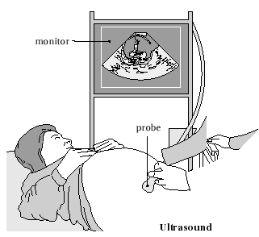
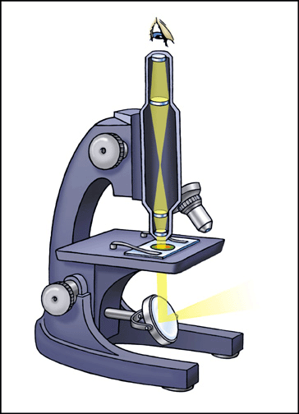
Problem statement: capturing
Mathematically a variety of capturing principles can be described by the Fredholm integral of the first kind
where x,t ℝ², v(t) is a point-spread function (PSF) of a system, y(t) is a function of a real object and z(x) is an observed signal.
Photo
Tomography
Microscopy

Slide 71
Image deblurring: problem statement
Mathematically blur is caused by the convolution of an image with the distorting kernel.
Thus, removal of the blur is reduced to the deconvolution.
Deconvolution is an ill-posed problem, which results in the instability of a solution. The best way to solve it is to use some regularization technique.
To use any kind of regularization technique, it is absolutely necessary to know the distorting kernel corresponding to a particular blur: so it is necessary to identify the blur.

Slide 72
Blur Identification
We use multilayer neural network based on multi-valued neurons (MLMVN) to recognize Gaussian, motion and rectangular (boxcar) blurs.
We aim to identify simultaneously both blur and its parameters using a single neural network.

Slide 73
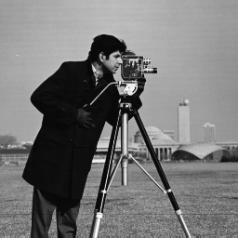



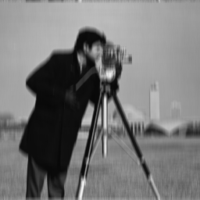
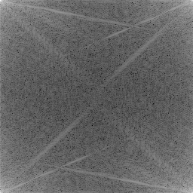
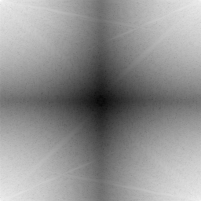
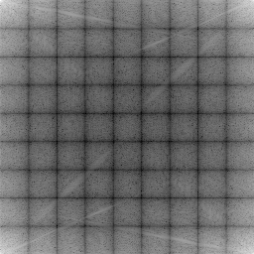
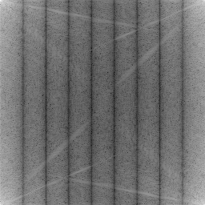
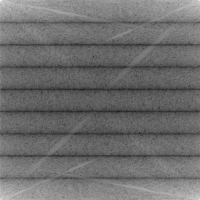
Degradation in the frequency domain:
True Image
Gaussian
Rectangular
Horizontal
Motion
Vertical
Motion
Images and log of their Power Spectra

Slide 74
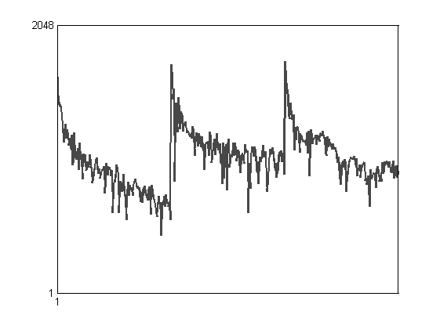
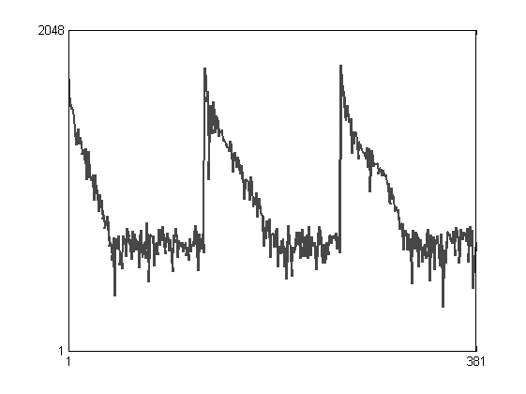
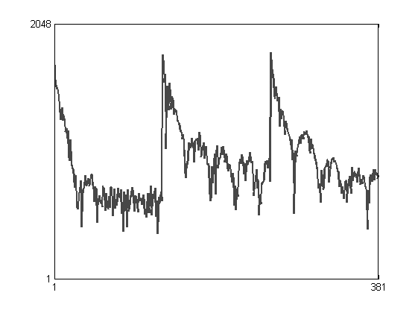
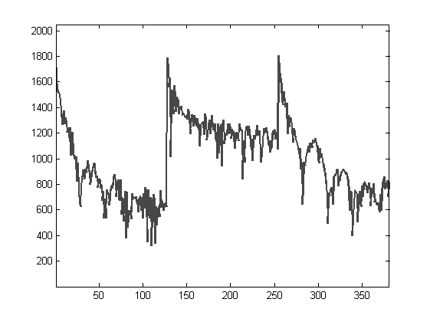
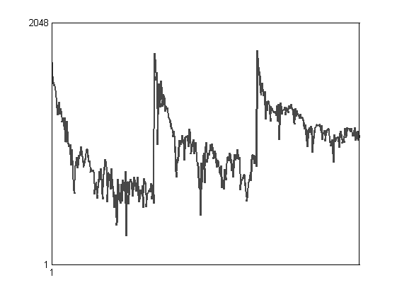
Examples of training vectors
True Image
Gaussian
Rectangular
Horizontal
Motion
Vertical
Motion

Slide 75
Neural Network 5→35→6
Training (pattern) vectors
1
Blur 1
2
Blur 2
n
Blur N
Hidden layers Output layer

Slide 76
Simulation
Experiment 1 (2700 training pattern vectors corresponding to 72 images): six types of blur with the following parameters:
MLMVN structure: 5→35→6
1) The Gaussian blur is considered with
2) The linear uniform horizontal motion blur of the lengths 3, 5, 7, 9;
3) The linear uniform vertical motion blur of the length 3, 5, 7, 9;
4) The linear uniform diagonal motion from South-West to North- East blur of the lengths 3, 5, 7, 9;
5) The linear uniform diagonal motion from South-East to North- West blur of the lengths 3, 5, 7, 9;
6) rectangular has sizes 3x3, 5x5, 7x7, 9x9.

Slide 77
Results
Classification Results
Blur | MLMVN, 381 inputs, 5→35→6, 2336 weights in total | SVM Ensemble from 27 binary decision SVMs, 25.717.500 support vectors in total
No blur | 96.0% | 100.0%
Gaussian | 99.0% | 99.4%
Rectangular | 99.0% | 96.4
Motion horizontal | 98.5% | 96.4
Motion vertical | 98.3% | 96.4
Motion North-East Diagonal | 97.9% | 96.5
Motion North-West Diagonal | 97.2% | 96.5

Slide 78




Restored images
Blurred noisy image:
rectangular 9x9
Blurred noisy image:
Gaussian, σ=2
Restored
Restored

